Slide 1
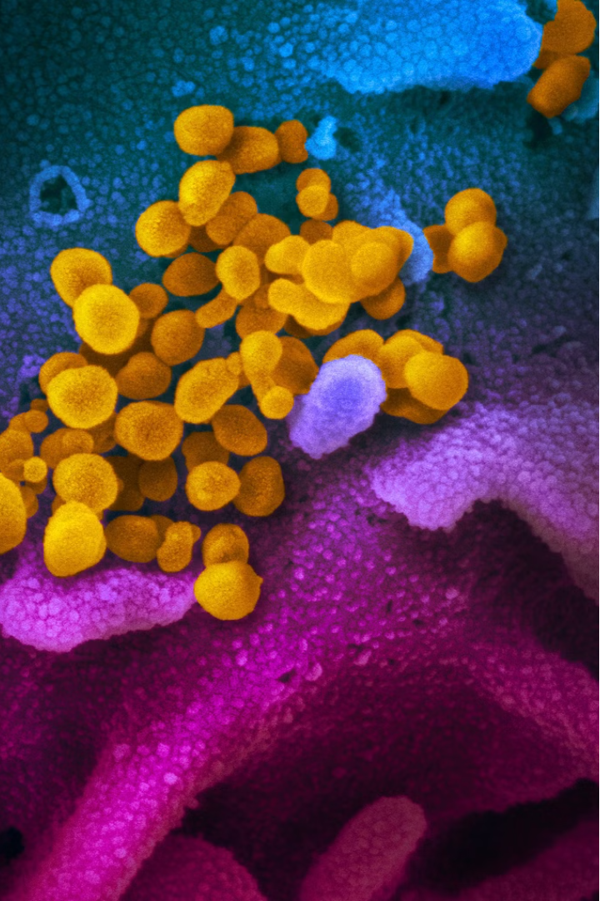

COVID-19's Impact on Liver Cancer Prediction
The COVID-19 pandemic has significantly disrupted healthcare systems worldwide, affecting the diagnosis and management of various conditions, including liver cancer. Understanding the pandemic's impact is crucial for enhancing liver cancer prediction and patient care during these challenging times.

Slide 2
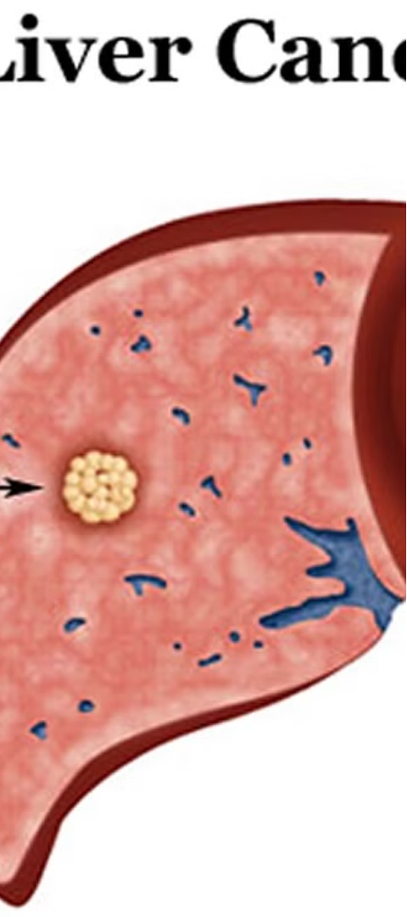
Overview of Liver Cancer
1
Liver Cancer Basics
2
Diagnostic Challenges
Liver cancer is a serious and complex disease that poses significant challenges in early detection and treatment.
Accurate diagnosis of liver cancer often requires advanced imaging techniques and specialized expertise, which can be impacted during the pandemic.
3
Importance of Early Detection
Early detection of liver cancer is crucial for improving patient outcomes, but the pandemic has disrupted screening and diagnostic services.

Slide 3
Challenges in Liver Cancer Prediction
Disrupted Patient Routines
Resource Constraints
Data Availability Challenges
Healthcare systems have faced significant resource constraints, leading to limited access to specialized diagnostic tests and clinicians, hampering liver cancer prediction efforts.
The pandemic has led to changes in patient behaviors, such as delayed healthcare-seeking and reduced follow-up visits, which can impact liver cancer risk assessment.
The pandemic has disrupted data collection and clinical research, making it more difficult to update and validate liver cancer prediction models.

Slide 4

Impact on Liver Cancer Screening and Early Detection
Diagnostic Backlog
Reduced Screening
The strain on healthcare resources has resulted in a backlog of liver cancer diagnostic tests, further hindering early detection efforts.
The pandemic has led to a significant decline in routine liver cancer screening, delaying the identification of early-stage cancers.
1
2
3
Delayed Diagnosis
Patients have been hesitant to seek medical care due to fear of COVID-19 exposure, leading to delayed liver cancer diagnoses.

Slide 5
Adaptations in Liver Cancer Risk Assessment
Telehealth Integration
Innovative Prediction Models
The increased use of telehealth has enabled remote risk assessment and monitoring for liver cancer patients, mitigating the impact of the pandemic.
Researchers are developing novel liver cancer prediction models that leverage AI and big data to overcome pandemic-related data challenges.
Personalized Approaches
Multidisciplinary Collaboration
Tailored risk assessment strategies, considering individual patient factors and preferences, have become more important during the pandemic.
Increased coordination between healthcare providers, researchers, and policymakers is crucial for improving liver cancer risk assessment during COVID-19.

Slide 6



Telemedicine and Remote Monitoring
Virtual Consultations
Remote Monitoring
Data-Driven Insights
Telemedicine has enabled remote liver cancer consultations, allowing clinicians to provide care while minimizing COVID-19 exposure risks.
Connected devices and digital tools have facilitated the remote monitoring of liver cancer patients, improving care continuity during the pandemic.
The increased use of telehealth and remote monitoring has generated valuable data to enhance liver cancer risk prediction and management.

Slide 7
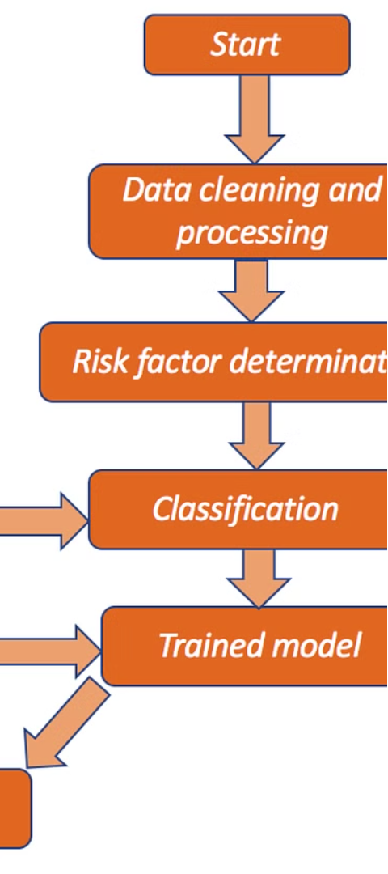



Emerging Technologies in Liver Cancer Prediction
AI and Machine Learning
Advancements in artificial intelligence and machine learning have enabled the development of more accurate and efficient liver cancer prediction models.
Genomic Profiling
Leveraging genomic data has become increasingly important for personalizing liver cancer risk assessment and guiding targeted interventions.
Digital Biomarkers
The integration of digital health technologies has led to the discovery of novel biomarkers that can enhance liver cancer prediction capabilities.

Slide 8
The Path Forward
Collaborative Efforts
Strengthening multidisciplinary partnerships to address the challenges of liver cancer prediction during the pandemic.
Technological Advancements
Leveraging emerging technologies, such as AI and digital health, to improve liver cancer risk assessment and early detection.
Personalized Approaches
Developing tailored liver cancer prediction models that consider individual patient characteristics and preferences.
Resilient Healthcare Systems
Enhancing the resilience of healthcare systems to ensure the continuity of liver cancer screening and diagnostic services during crises.

Slide 9
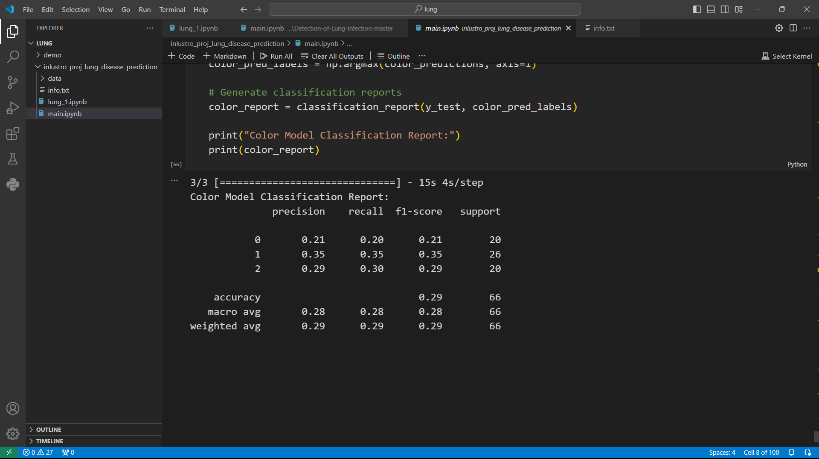
OUTPUT:

Slide 10
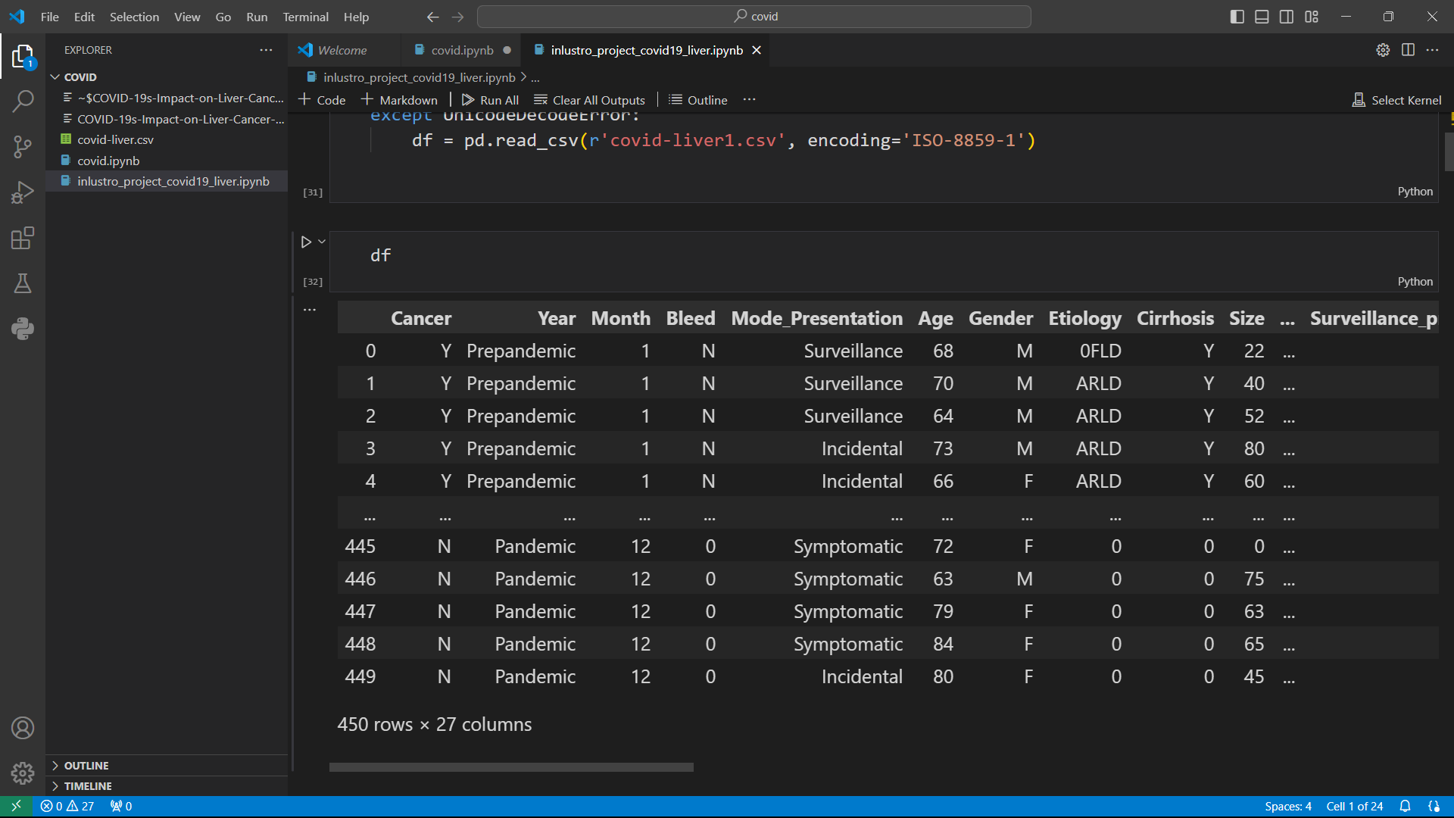
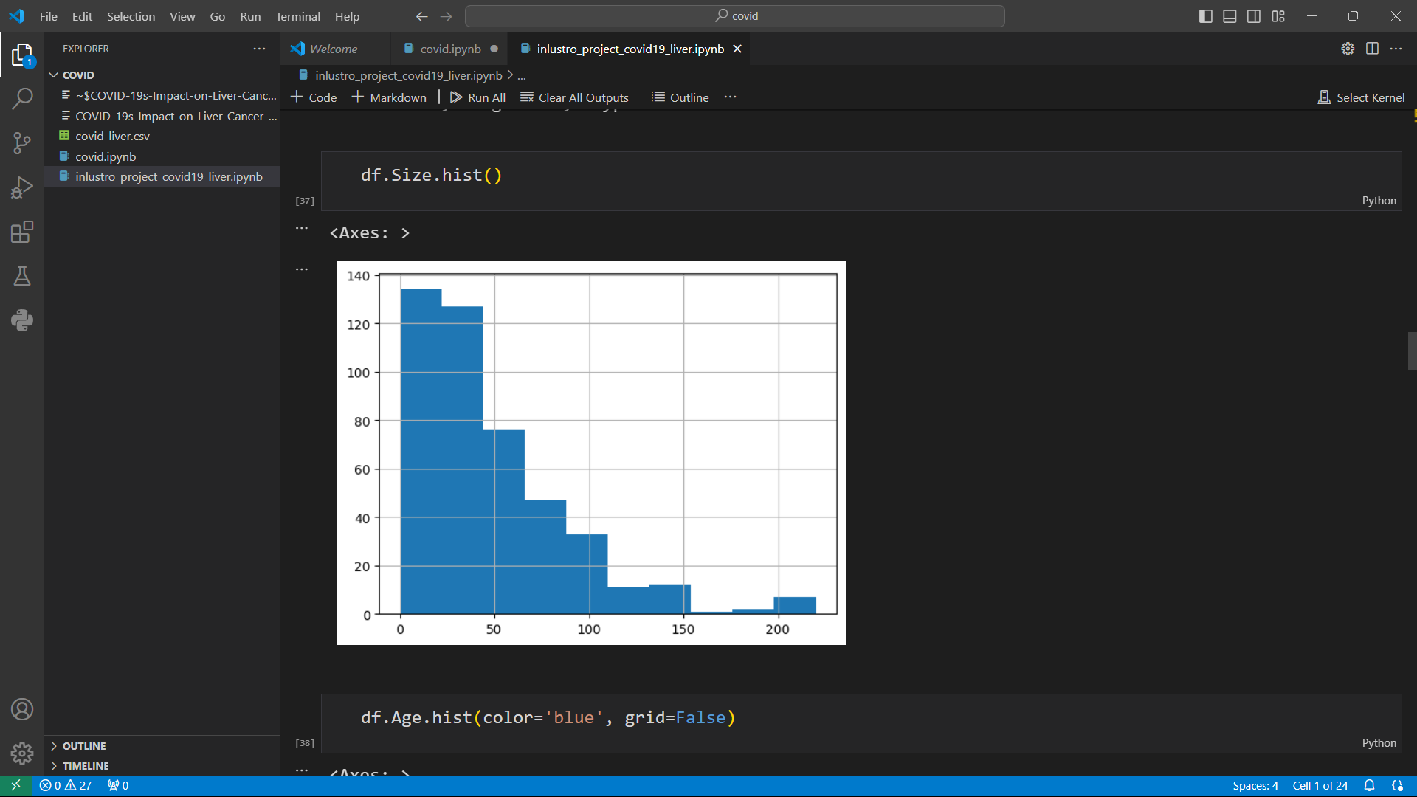

Slide 11
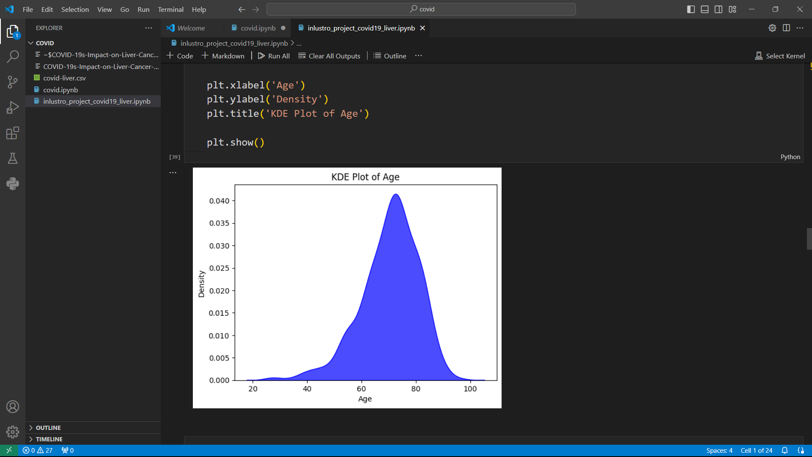
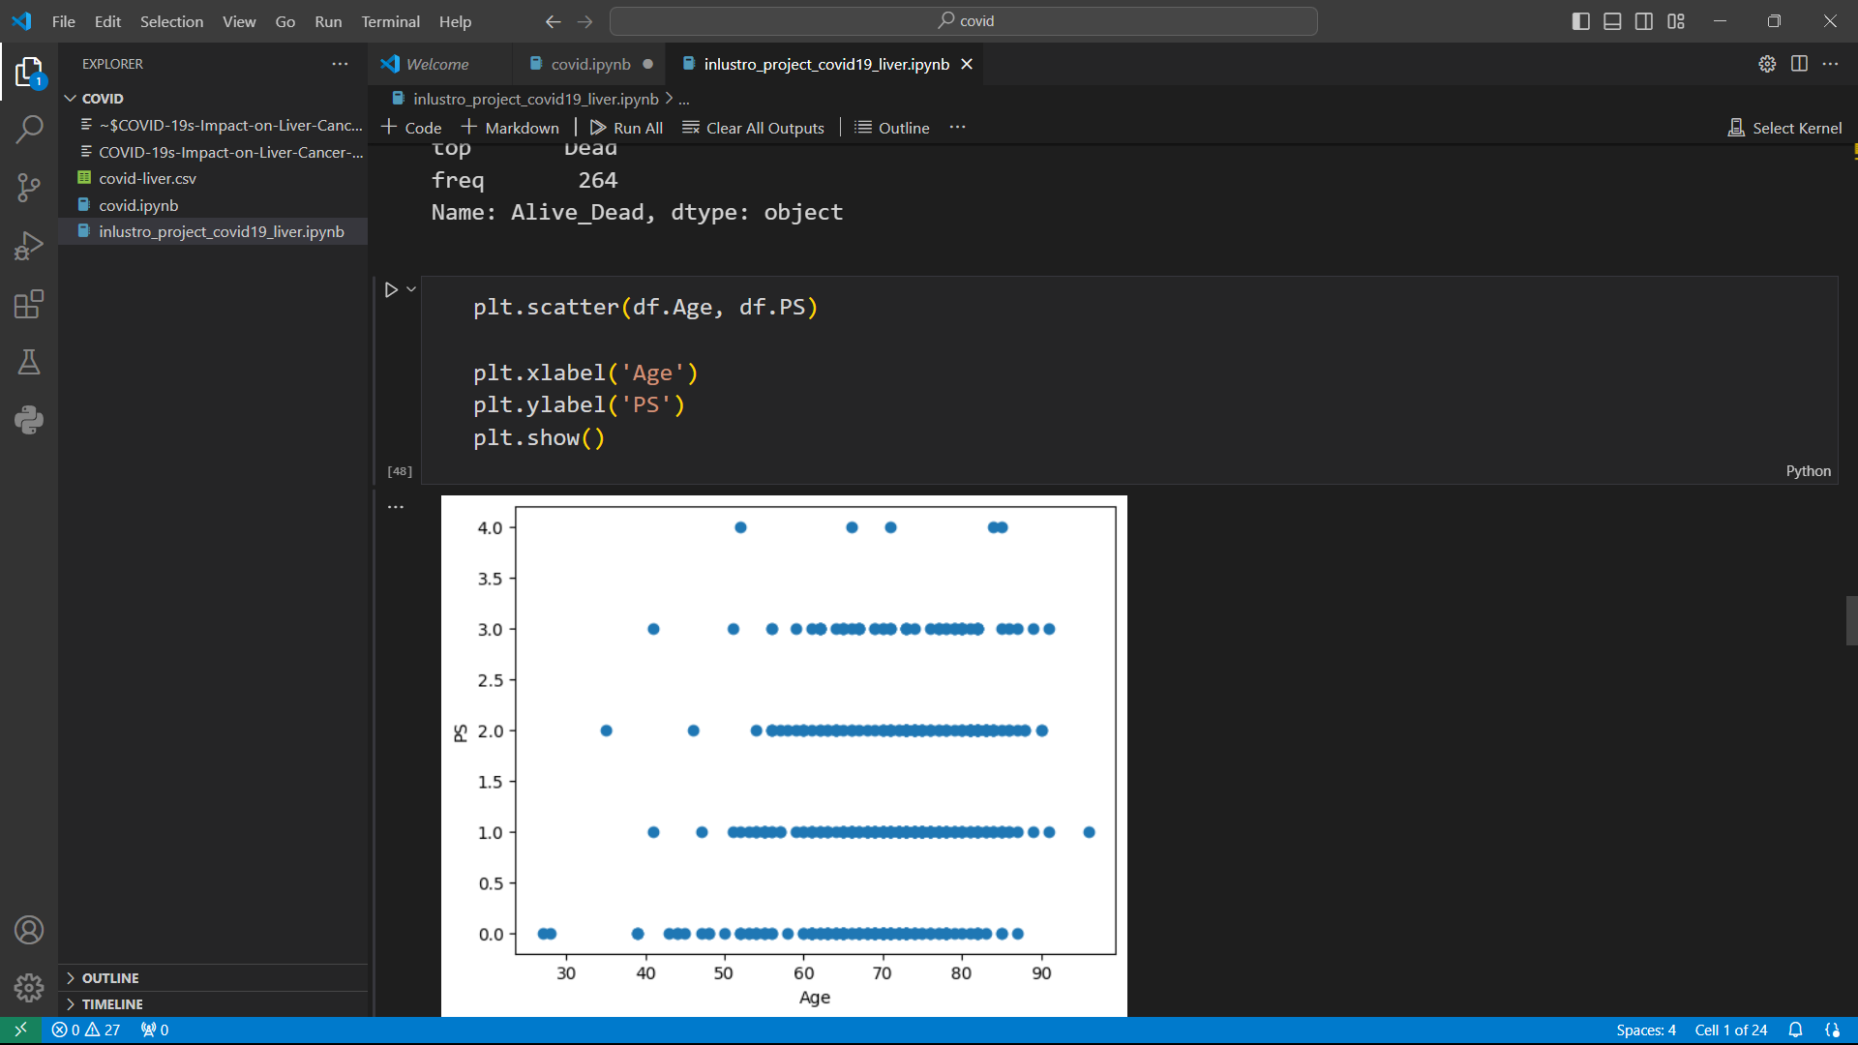

Slide 12
